Slide 1


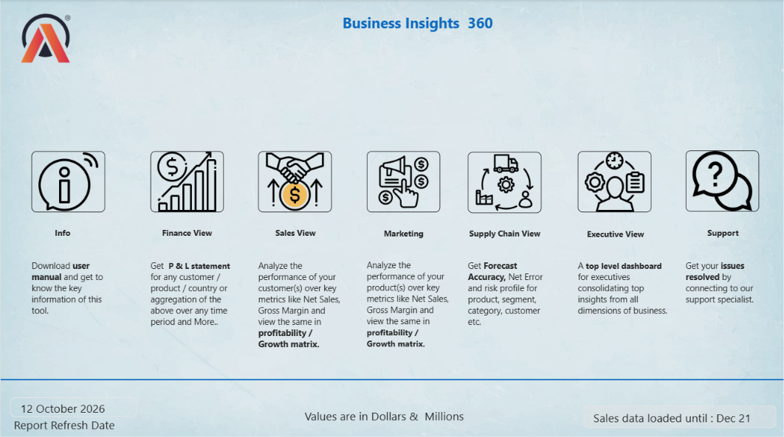

Business Insights 360
POWER BI PROJECT PRESENATION
lAZAR ARUN KUMAR B

Slide 2

Introduction
Business Insights 360 is a Power BI project focused on understanding business performance through data analytics.
In this project, I learned how to transform raw data into meaningful insights using SQL, Excel, Power Query, Power BI and DAX. The project covers five major business areas: Finance, Sales, Marketing, Supply Chain and Executive.
The main objective is to bring business insights together in interactive dashboards that help users understand performance, identify trends and make data-driven decisions.
Through this project, I gained practical knowledge of data preparation, data modeling, DAX calculations, dashboard development and business analysis.

Slide 3


Project overview
Business Insights 360 is a business intelligence project based on AtliQ Hardware, a consumer electronics company. The project focuses on analyzing business data across five departments: Finance, Sales, Marketing, Supply Chain and Executive.
Using SQL, Excel and Power BI, the data is prepared, transformed and analyzed to create interactive dashboards. These dashboards help track key performance indicators (KPIs), understand business trends, evaluate profitability and support data-driven decision-making.
The goal is to provide a consolidated view of business performance and help stakeholders make better business decisions.

Slide 4
Objectives
1
2
3
Business Performance Analysis:
Analyze performance across Finance, Sales, Marketing and Supply Chain, including sales trends, profitability and customer performance.
Interactive Dashboard
Development:
Develop interactive Power BI dashboards to monitor key performance indicators (KPIs) and present business data clearly.
Insights & Decision-Making
Identify areas for improvement and provide meaningful insights to support data-driven business decisions.

Slide 5



AtliQ Harware
AtliQ Hardware operates in the consumer electronics industry, dealing with products such as computers and computer accessories. As the business grows across markets and sales channels, understanding its financial performance, customer behaviour, product sales and supply chain operations becomes important.
Business Insights 360 demonstrates how data analytics can help bring these different business areas together and support better decision-making.

Slide 6
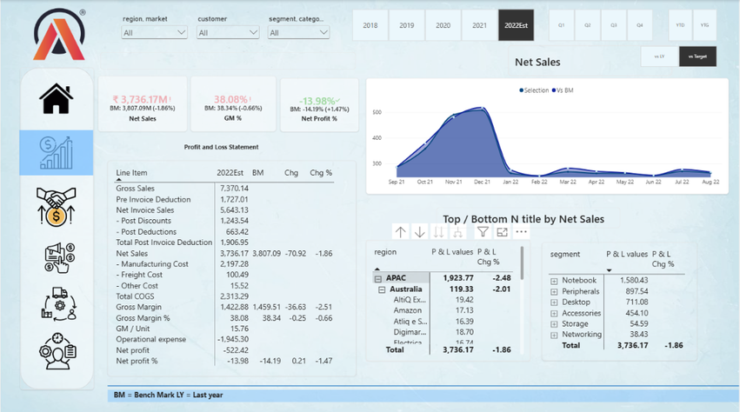
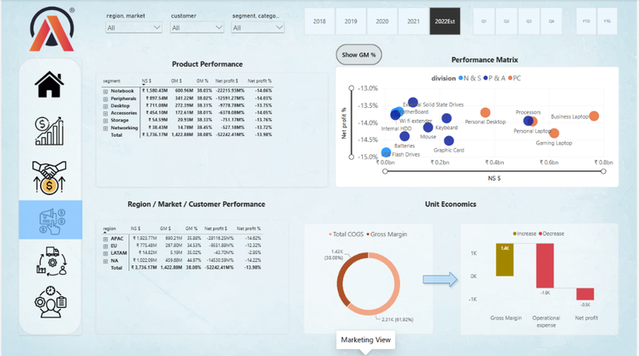
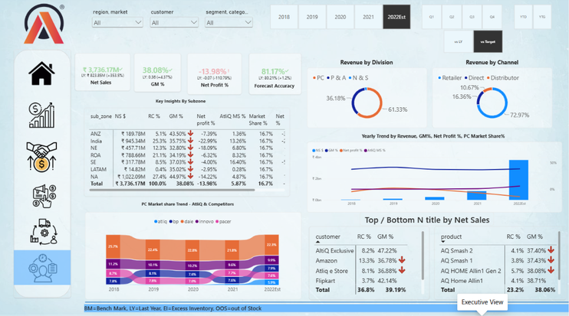

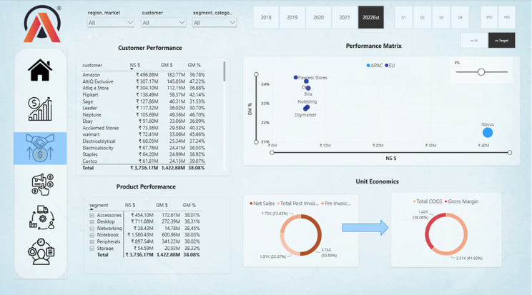
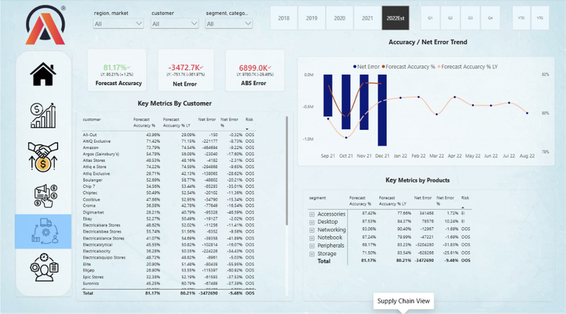
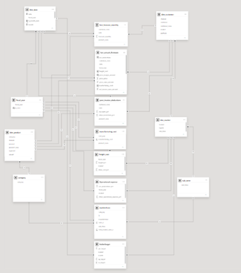
Business Insights 360
Finance View
Sales View
Marketing View
Supply Chain View
Data Modelling
Executive View

Slide 7


PROJECT PLANNING
Before building dashboards, it is important to understand what the business needs.
KEY ACTIVITIES:
  Understanding the problem statement
  Identifying stakeholders and business requirements
  Defining project scope and deliverables
  Reviewing the project charter
  Identifying key performance indicators (KPIs)
KEY TAKEAWAY:
Good analysis starts with the right business questions.

Slide 8
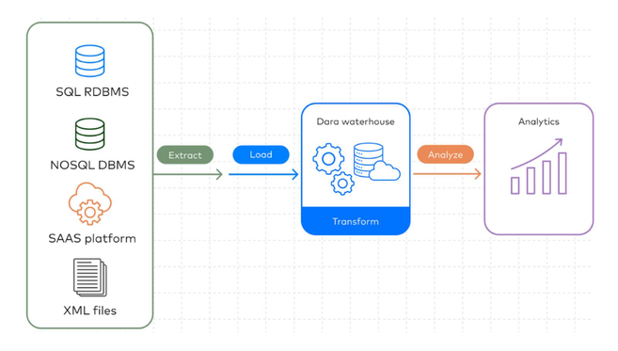
Data Collection & Preparation
FROM RAW DATA TO ANALYSIS-READY DATA
The first step was understanding the available data and preparing it for analysis.
KEY CONCEPTS:
• Data collection and exploration
• ETL — Extract, Transform, Load
• OLTP vs. OLAP
• Data catalog
• Importing data from MySQL
• Data validation and benchmark checks
TOOLS:
MySQL | Power Query

Slide 9
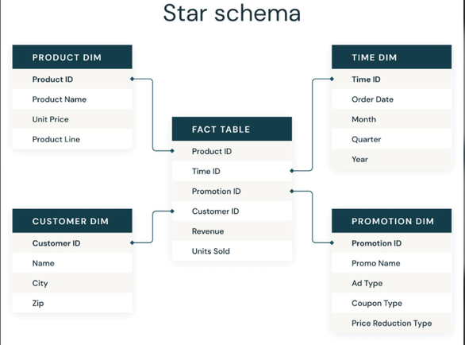
Data Modeling & Transformation
BUILDING THE DATA MODEL:
A well-designed data model helps organize data and supports accurate analysis.
WHAT I LEARNED
• Transforming data using Power Query (M)
• Understanding star schema and snowflake dimensions
• Working with fact and dimension tables
• Establishing relationships between tables
• Creating calculated columns
• Validating model outputs
KEY TAKEAWAY:
A reliable data model is the foundation of effective reporting.

Slide 10
DAX & Key Business Metrics
TURNING BUSINESS REQUIREMENTS INTO CALCULATIONS
DAX (Data Analysis Expressions) helps create calculations used in Power BI reports.
KEY LEARNINGS:
• Creating calculated columns and measures
• Preparing a list of business metrics
• Understanding filter context
• Validating calculations against benchmark numbers
• Using DAX Studio to examine report performance
EXAMPLE METRICS
Net Sales | Gross Margin | Gross Margin % | Net Profit
KEY TAKEAWAY:
The right calculations help turn raw data into useful business measures.

Slide 11
FINANCE VIEW
FINANCE VIEW — UNDERSTANDING PROFITABILITY
This view focuses on financial performance and the metrics used to understand revenue and profitability.
KEY BUSINESS TERMS:
• Gross Price
• Pre-Invoice Deductions
• Net Invoice Sales
• Post-Invoice Deductions
• Net Sales
• Cost of Goods Sold (COGS)
• Gross Margin and Net Profit
• YTD (Year to Date) and YTG (Year to Go)
BUSINESS PURPOSE:
Help users examine financial performance using consistent metrics.

Slide 12
SALES VIEW
SALES VIEW : CUSTOMER & PRODUCT PERFORMANCE
This view helps analyze how customers and products contribute to sales performance.
KEY AREAS
• Customer performance
• Product performance
• Net Sales and Gross Margin %
• Customer performance against GM% targets
• Comparing performance across selected periods
BUSINESS QUESTION
Are customers meeting the Gross Margin % targets?

Slide 13
Marketing View
MARKETING VIEW: MARKET & PRODUCT ANALYSIS
This view provides a way to explore marketing performance and profitability.
KEY AREAS:
• Product performance
• Market performance
• Profitability analysis
• Gross Margin % trends
• Comparing business performance across markets
BUSINESS PURPOSE:
Understand which products and markets contribute to business performance.

Slide 14
SUPPLY CHAIN VIEW
SUPPLY CHAIN VIEW: FORECAST PERFORMANCE
This view focuses on forecast accuracy and supply chain-related metrics.
KEY AREAS:
• Forecast accuracy
• Net error
• Forecast performance trends
• Identifying areas that may need attention
BUSINESS PURPOSE:
Help teams understand forecast performance and support better planning.

Slide 15
Executive View
EXECUTIVE VIEW : THE BIGGER PICTURE
The Executive View brings key business indicators together to provide a high-level overview of performance.
KEY AREAS:
• Overall business performance
• Important KPIs
• Sales and profitability trends
• High-level comparisons across business areas
BUSINESS PURPOSE:
Help teams understand forecast performance and support better planning.

Slide 16
Interactive Reporting & Publishing
MAKING REPORTS INTERACTIVE AND ACCESSIBLE
POWER BI TECHNIQUES:
• Bookmarks to switch between visuals
• Page navigation buttons
• Dynamic titles based on applied filters
• KPI indicators
• Conditional formatting
• Report publishing through Power BI Service
• Personal gateway and scheduled refresh concepts
KEY TAKEAWAY
Reports should be easy to navigate, understand and maintain.

Slide 17
Key Learnings & Thank You
MY KEY TAKEAWAYS:
This project helped me connect data preparation, data modeling, DAX and dashboard development with business requirements.
I learned that effective data analytics involves more than creating visuals. It requires understanding the problem, validating the data, choosing meaningful metrics and presenting information clearly.
WHAT'S NEXT?
Continue practising, building projects and improving my skills as an aspiring Data Analyst.
THANK YOU!

Slide 18
THANK YOU

